Slide 1


Computer Networks
Lectures (Chapter3)
Transport Layer
Subhan Ullah, PhD
subhan.ullah@nu.edu.pk
BS(Computer Science) Fall-2022

Slide 2
rdt2.2: a NAK-free protocol
same functionality as rdt2.1, using ACKs only
instead of NAK, receiver sends ACK for last pkt received OK
receiver must explicitly include seq # of pkt being ACKed
duplicate ACK at sender results in same action as NAK: retransmit current pkt
As we will see, TCP uses this approach to be NAK-free
Notes:
If a corrupted packet is found, the ACK segment with the SEQ# of the previously acknowledge segment is sent to the sending side.
Duplicated acknowledgment methodology is really used in the real protocol - TCP

Slide 3
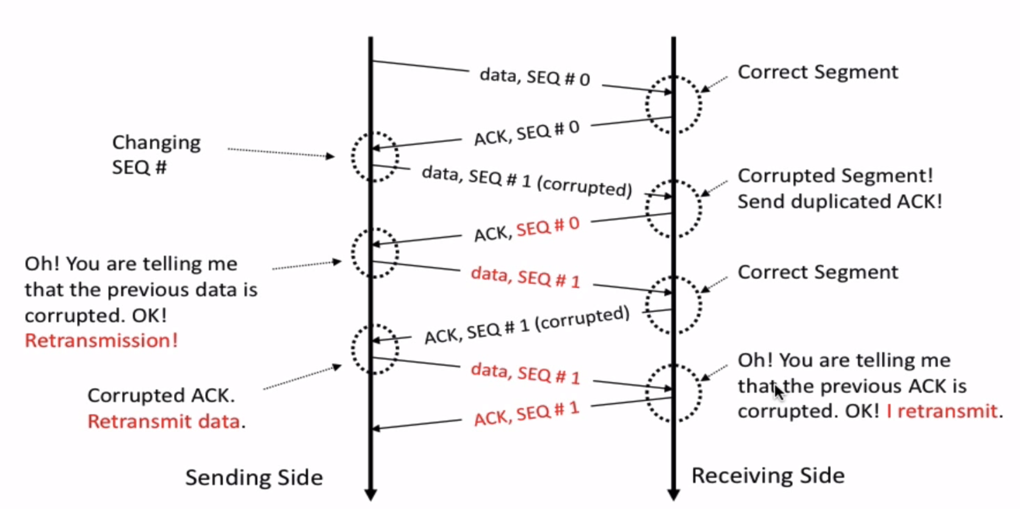
Rdt 2.2 in action
Notes:
Section G (covered 10/27/2021).

Slide 4
rdt2.2: sender, receiver fragments
rdt_send(data)
sndpkt = make_pkt(0, data, checksum)
udt_send(sndpkt)
rdt_rcv(rcvpkt) &&
( corrupt(rcvpkt) ||
isACK(rcvpkt,1) )
Wait for call 0 from above
Wait for ACK
0
udt_send(sndpkt)
sender FSM
fragment
rdt_rcv(rcvpkt)
&& notcorrupt(rcvpkt)
&& isACK(rcvpkt,0)
rdt_rcv(rcvpkt) &&
(corrupt(rcvpkt) ||
has_seq1(rcvpkt))
Λ
Wait for
0 from below
receiver FSM
fragment
udt_send(sndpkt)
rdt_rcv(rcvpkt) && notcorrupt(rcvpkt)
&& has_seq1(rcvpkt)
extract(rcvpkt,data)
deliver_data(data)
sndpkt = make_pkt(ACK1, chksum)
udt_send(sndpkt)

Slide 5
rdt2.2: a NAK free protocol - Sender
rdt_send(data)
Sender sends
Packet 0
sndpkt = make_pkt(0, data, checksum)
udt_send(sndpkt)
rdt_rcv(rcvpkt) &&
( corrupt(rcvpkt) ||
isACK(rcvpkt,1))
Resend, If
packet is
Corrupt or
duplicate ACK
Wait for call 0 from above
Wait for ACK or NAK 0
udt_send(sndpkt)
rdt_rcv(rcvpkt)
&& notcorrupt(rcvpkt)
&& isACK(rcvpkt,1)
rdt_rcv(rcvpkt)
&& notcorrupt(rcvpkt)
&& isACK(rcvpkt,0)
If all is fine
move on and
Send packet 1
Λ
Λ
Wait for ACK or NAK 1
Wait for
call 1 from above
rdt_rcv(rcvpkt) &&
( corrupt(rcvpkt) ||
isACK(rcvpkt,0))
rdt_send(data)
Sender sends
Packet 1 …
udt_send(sndpkt)
sndpkt = make_pkt(1, data, checksum)
udt_send(sndpkt)

Slide 6
rdt2.2: a NAK free protocol - Receiver
rdt_rcv(rcvpkt) && notcorrupt(rcvpkt)
&& has_seq0(rcvpkt)
Packet received correctly with
seq0, extract and deliver data to
upper layers and send back ACK
Packet received but corrupt, send NAK
extract(rcvpkt,data)
deliver_data(data)
sndpkt = make_pkt(ACK, chksum)
udt_send(sndpkt)
rdt_rcv(rcvpkt) && (corrupt(rcvpkt)
rdt_rcv(rcvpkt) && (corrupt(rcvpkt)
sndpkt = make_pkt(NAK, chksum)
udt_send(sndpkt)
sndpkt = make_pkt(NAK, chksum)
udt_send(sndpkt)
Wait for
0 from below
Wait for
1 from below
rdt_rcv(rcvpkt) &&
not corrupt(rcvpkt) &&
has_seq1(rcvpkt)
rdt_rcv(rcvpkt) &&
not corrupt(rcvpkt) &&
has_seq0(rcvpkt)
sndpkt = make_pkt(ACK, chksum)
udt_send(sndpkt)
sndpkt = make_pkt(ACK, chksum)
udt_send(sndpkt)
rdt_rcv(rcvpkt) && notcorrupt(rcvpkt)
&& has_seq1(rcvpkt)
Packet received, not corrupt but has seq 1,
Send ACK again
Packet received, not corrupt but has seq 0,
Send ACK again
extract(rcvpkt,data)
deliver_data(data)
sndpkt = make_pkt(ACK, chksum)
udt_send(sndpkt)

Slide 7
rdt2.2: a NAK free protocol - Receiver
rdt_rcv(rcvpkt) && notcorrupt(rcvpkt)
&& has_seq0(rcvpkt)
Packet received correctly with
seq0, extract and deliver data to
upper layers and send back ACK
extract(rcvpkt,data)
deliver_data(data)
sndpkt = make_pkt(ACK, chksum)
udt_send(sndpkt)
rdt_rcv(rcvpkt) && (corrupt(rcvpkt)
rdt_rcv(rcvpkt) &&
(corrupt(rcvpkt) ||
has_seq1(rcvpkt))
sndpkt = make_pkt(NAK, chksum)
udt_send(sndpkt)
Wait for
0 from below
Wait for
1 from below
sndpkt=make_pkt(ACK,1,checksum)
udt_send(sndpkt)
rdt_rcv(rcvpkt) &&
not corrupt(rcvpkt) &&
has_seq0(rcvpkt)
sndpkt = make_pkt(ACK, chksum)
udt_send(sndpkt)
rdt_rcv(rcvpkt) && notcorrupt(rcvpkt)
&& has_seq1(rcvpkt)
Packet received, not corrupt but has seq 0,
Send ACK again
extract(rcvpkt,data)
deliver_data(data)
sndpkt = make_pkt(ACK, chksum)
udt_send(sndpkt)

Slide 8
rdt2.2: a NAK free protocol - Receiver
rdt_rcv(rcvpkt) && notcorrupt(rcvpkt)
&& has_seq0(rcvpkt)
extract(rcvpkt,data)
deliver_data(data)
sndpkt = make_pkt(ACK, chksum)
udt_send(sndpkt)
rdt_rcv(rcvpkt) &&
(corrupt(rcvpkt) ||
has_seq1(rcvpkt))
rdt_rcv(rcvpkt) &&
(corrupt(rcvpkt) ||
has_seq0(rcvpkt))
Wait for
0 from below
Wait for
1 from below
sndpkt=make_pkt(ACK,1,checksum)
udt_send(sndpkt)
sndpkt=make_pkt(ACK,0,checksum)
udt_send(sndpkt)
rdt_rcv(rcvpkt) && notcorrupt(rcvpkt)
&& has_seq1(rcvpkt)
extract(rcvpkt,data)
deliver_data(data)
sndpkt = make_pkt(ACK, chksum)
udt_send(sndpkt)

Slide 9
rdt3.0: channels with errors and loss
New channel assumption: underlying channel can also lose packets (data, ACKs)
checksum, sequence #s, ACKs, retransmissions will be of help … but not quite enough
Q: How do humans handle lost sender-to-receiver words in conversation?

Slide 10

rdt3.0: channels with errors and loss
Approach: sender waits “reasonable” amount of time for ACK
retransmits if no ACK received in this time
if pkt (or ACK) just delayed (not lost):
retransmission will be duplicate, but seq #s already handles this!
receiver must specify seq # of packet being ACKed
use countdown timer to interrupt after “reasonable” amount of time
timeout

Slide 11
rdt3.0 sender
rdt_send(data)
sndpkt = make_pkt(0, data, checksum)
udt_send(sndpkt)
start_timer
Wait for
call 0 from above
Wait for ACK0
rdt_rcv(rcvpkt)
&& notcorrupt(rcvpkt)
&& isACK(rcvpkt,1)
rdt_rcv(rcvpkt)
&& notcorrupt(rcvpkt)
&& isACK(rcvpkt,0)
stop_timer
stop_timer
Wait for ACK1
Wait for
call 1 from above
rdt_send(data)
sndpkt = make_pkt(1, data, checksum)
udt_send(sndpkt)
start_timer
Notes:
We see the familiar four state sender from our rdt 2.1 and 2.2 protocols. Top two states when sending packet with zero seq # and bottom two

Slide 12
rdt3.0 sender
rdt_send(data)
rdt_rcv(rcvpkt) &&
( corrupt(rcvpkt) ||
isACK(rcvpkt,1) )
sndpkt = make_pkt(0, data, checksum)
udt_send(sndpkt)
start_timer
rdt_rcv(rcvpkt)
Λ
Λ
Wait for
call 0 from above
Wait for ACK0
timeout
udt_send(sndpkt)
start_timer
rdt_rcv(rcvpkt)
&& notcorrupt(rcvpkt)
&& isACK(rcvpkt,1)
rdt_rcv(rcvpkt)
&& notcorrupt(rcvpkt)
&& isACK(rcvpkt,0)
stop_timer
stop_timer
Wait for ACK1
Wait for
call 1 from above
timeout
udt_send(sndpkt)
start_timer
rdt_rcv(rcvpkt)
rdt_send(data)
Λ
rdt_rcv(rcvpkt) &&
( corrupt(rcvpkt) ||
isACK(rcvpkt,0) )
sndpkt = make_pkt(1, data, checksum)
udt_send(sndpkt)
start_timer
Λ
Notes:
We see the familiar four state sender from our rdt 2.1 and 2.2 protocols. Top two states when sending packet with zero seq # and bottom two

Slide 13

rdt3.0 in action
sender
receiver
sender
receiver
send pkt0
pkt0
send pkt0
pkt0
rcv pkt0
rcv pkt0
ack0
send ack0
ack0
send ack0
rcv ack0
rcv ack0
send pkt1
pkt1
send pkt1
pkt1
rcv pkt1
X
ack1
send ack1
loss
rcv ack1
send pkt0
pkt0
rcv pkt0
timeout
resend pkt1
ack0
send ack0
pkt1
rcv pkt1
ack1
send ack1
rcv ack1
send pkt0
pkt0
(a) no loss
rcv pkt0
ack0
send ack0
(b) packet loss

Slide 14
rdt3.0 in action
sender
receiver
sender
receiver
send pkt0
pkt0
rcv pkt0
send pkt0
pkt0
send ack0
rcv pkt0
rcv ack0
ack0
ack0
send ack0
send pkt1
pkt1
rcv ack0
rcv pkt1
send pkt1
pkt1
send ack1
rcv pkt1
ack1
ack1
send ack1
X
timeout
resend pkt1
loss
pkt1
rcv pkt1
timeout
resend pkt1
rcv ack1
(detect duplicate)
pkt1
rcv pkt1
send ack1
send pkt0
pkt0
ack1
(detect duplicate)
rcv pkt0
rcv ack1
send ack1
rcv ack1
ack1
ack0
send ack0
send pkt0
pkt0
(ignore)
rcv pkt0
ack0
send ack0
pkt1
(c) ACK loss
(d) premature timeout/ delayed ACK

Slide 15
Performance of rdt3.0 (stop-and-wait)
U _{sender}: utilization – fraction of time sender busy sending
example: 1 Gbps link, 15 ms prop. delay, 8000 bit packet
time to transmit packet into channel:
L
8000 bits
D_{trans} =
=
=
8 microsecs
R
10⁹ bits/sec
Notes:
if RTT=30 msec, 1KB pkt every 30 msec: 33kB/sec thruput over 1 Gbps link
network protocol limits use of physical resources
Let’s develop a formula for utilization

Slide 16
rdt3.0: stop-and-wait operation
sender
receiver
first packet bit transmitted, t = 0
first packet bit arrives
RTT
last packet bit arrives, send ACK
ACK arrives, send next
packet, t = RTT + L / R

Slide 17
rdt3.0: stop-and-wait operation
sender
receiver
L / R
=
L/R
U_{sender}
RTT
+ L / R
.008
RTT
=
30.008
=
0.00027
rdt 3.0 protocol performance stinks!
Protocol limits performance of underlying infrastructure (channel)
Notes:
.8 microsec = .0008 millisec

Slide 18
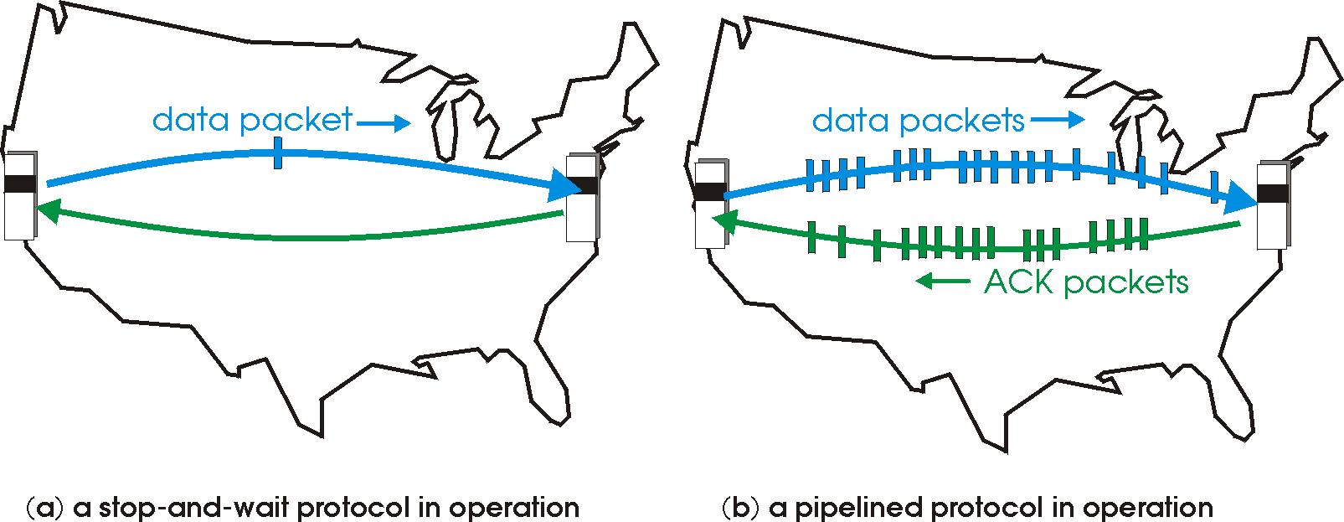

rdt3.0: pipelined protocols operation
pipelining: sender allows multiple, “in-flight”, yet-to-be-acknowledged packets
range of sequence numbers must be increased
buffering at sender and/or receiver

Slide 19
Pipelining: increased utilization
sender
receiver
first packet bit transmitted, t = 0
last bit transmitted, t = L / R
first packet bit arrives
RTT
last packet bit arrives, send ACK
last bit of 2nd packet arrives, send ACK
last bit of 3rd packet arrives, send ACK
ACK arrives, send next
packet, t = RTT + L / R
3-packet pipelining increases
utilization by a factor of 3!
Notes:
two generic forms of pipelined protocols: go-Back-N, selective repeat

Slide 20


Thank You All
☺
?
A note on the origin of these ppt slides:
All material copyright 1996-2020 J.F Kurose and K.W. Ross, All Rights Reserved
These slides are freely provided by the book authors and it represents a lot of work on their part. We would like to thank J.F Kurose and K.W. Ross.
Transport Layer: 3-150
Notes:
Section F and G ended

